Slide 1
Argumentation and use of literature

Slide 2
Agenda
What is an argument
How to argue?
Dealing with the argumentation in texts
Exercise
Notes:
Here you can introduce the students to the topic of the presentation.
The aim is to provide an overview of argumentation in academic texts and the use of literature in writing.
How can we argue in our assignments and how can we deal with the arguments of other texts?

Slide 3
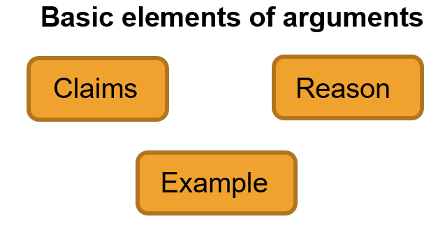
What is an argument?
An argument can be defined as a complex symbolic structure in which some parts, called premises, support another part, the conclusion (Dutihl Novaes, 2022).
Logic is the study of forms of argumentation and the development of standards and criteria for evaluating arguments.
Notes:
What is an argument? On this slide you will find a definition of the term "argument" that you can use to discuss the topic with the students.
You can also find more ideas on how to address the topic in the Writing Center's "How To Argumentation" document.
Arguments essentially consist of three parts:
Claim;
Reasons;
and an example (Writing Center - How To Argumentation).
We have also introduced the concept of logic as an introduction to the concepts of deduction, induction and abduction on the next slide.
Logic is important for building arguments and evaluating them.

Slide 4
What is an argument?
(Some) types of arguments
Deduction
The logical model in which specific expectations of hypotheses are developed on the basis of general principles. (Babbie, 2016, p. 525).
Moves from the general to the specific.
Examination of the existing theory.
Induction
The logical model in which general principles are developed from specific observations. (Babbie, 2016, p. 527).
Moving from the specific to the general.
Development of the theory.
Notes:
Following on from the topic of logic on the previous slide, this slide presents the definition of some types of arguments.
Suggestion: Before explaining the two types of reasoning, you should first ask the group. Ask if they know any type of argumentation and if they are willing to explain how they think it works.
The aim is to introduce students to some of the possible types of argumentation and to explain the reasons for this type of argumentation. A brief explanation and examples of deduction and induction can be found under the following link:
https://www.scribbr.com/methodology/inductive-deductive-reasoning/#:~:text=What's%20the%20difference%20between%20inductive,general%20premises%20to%20specific%20conclusions.

Slide 5
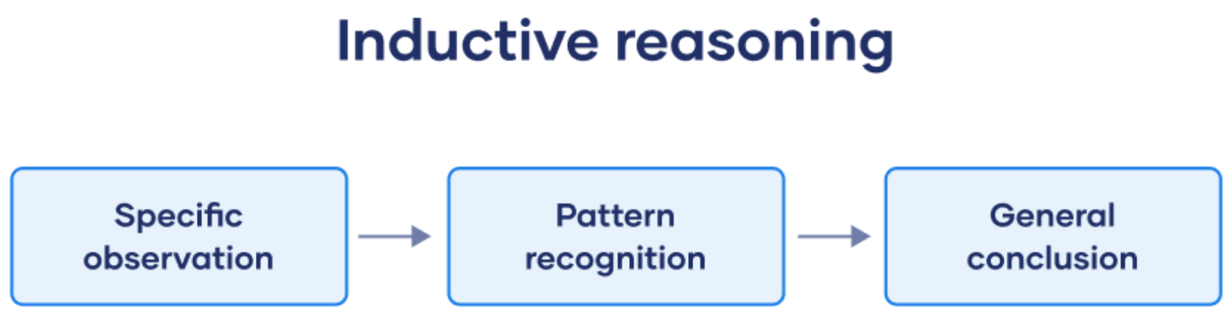
How to argue in your own academic papers
Inductive thinking in research
Inductive reasoning means drawing conclusions from certain observations.
Inductive research begins with observations or the collection of data. Then you can get an overview of the data and look for patterns. The final step is to draw general conclusions that can be incorporated into theories. (Bhandari, 2022).
Source:https://www.scribbr.com/methodology/inductive-reasoning/
Notes:
On this slide, we will take a closer look at the types of argumentation. The aim is to explain how this type of argumentation can be applied in the context of academic research.
The first type of reasoning we will look at is inductive reasoning.
The image was taken from this website: https://www.scribbr.com/methodology/inductive-reasoning/
You can find further ideas on how to introduce the topic on scribbr.

Slide 6
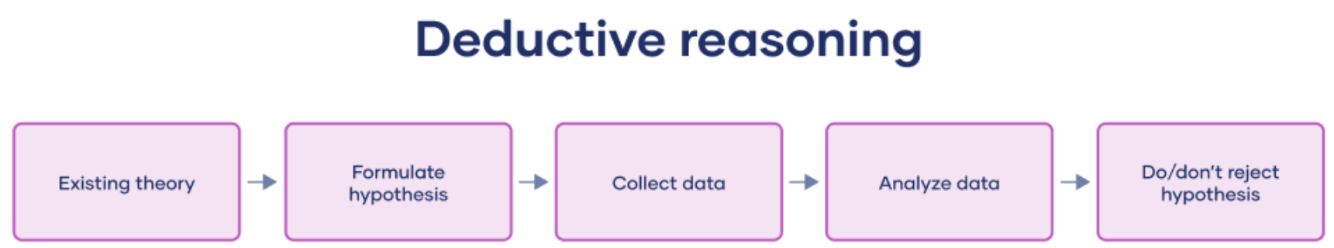
How to argue in your own academic papers
Deductive thinking in research
Moves from general principles to specific observations.
It is generally used for quantitative research.
"In research, you may have come across the so-called hypothetico-deductive method. This is a scientific method in which hypotheses are tested to see if the predictions are supported by real data." (Bhandari, 2022 - own translation).
Source:https://www.scribbr.com/methodology/dedutive-reasoning/
Notes:
The second reasoning we want to address is deductive reasoning. You can find more examples and explanations on this topic on the website (https://www.scribbr.com/methodology/dedutive-reasoning/)
Post-it note: "The methods you use influence your reasoning". This means that certain types of methods are related to or favor certain types of reasoning.
Example: Statistical methods with a large sample favor deductive reasoning.

Slide 7
How to argue in your own academic papers
Checklist for your own argumentation (Moll and Thielmann 2017, 181-82)
A prerequisite for argumentative writing is to have a position that you want to convince people of. Therefore, formulate your point of view or a thesis before you start writing. (Example: "I am of the opinion that...").
Before you start writing, formulate the aim of your argument (example: "I want to make it clear that ..." / "I want to convince F that ...").
Think about which materials and data you want to use to support your position or thesis (e.g. empirical data, quotes, images, graphics, etc.). Collect and group these materials in such a way that they relate to your argumentative goal.
(...)
Please consult the original material for the continuation of the list (Arguing - First steps)
Notes:
This checklist can be found in the document "Argumentation - First Steps" from the Writing Center. It is a guide on how to approach or write your own arguments.
You can go through the list with the students.
Tip: Ask the students what they do to check their own (written) arguments. Whether they can give their colleagues any other advice than that listed in the checklist.

Slide 8
How to argue in your own academic papers
Understanding is necessary in order to recognize the strengths and weaknesses of the arguments, among other things.
Understanding why an argument might be weak is also part of the task.
Critical reading
Critical reading makes it easier to understand arguments.
As you read, ask yourself questions like "What is the author trying to prove?" and "Do you agree with the author?". Does the author adequately justify their argument? (...)
As you become accustomed to reading critically, you will begin to recognize the sometimes hidden intentions of other writers, and you can use this skill to improve your own ability to formulate effective arguments." (UNC-Chapel Hill Writing Center, 2021 - own translation)
Notes:
In this final part of our presentation, we will look at how students can engage with the arguments of other texts.
An essential feature of engaging with the arguments of other texts is understanding the arguments.
It is important to clarify that the understanding of arguments is multi-layered and can be achieved, for example, through critical reading.

Slide 9
How to deal with an argument in other texts
Thesis and Claims
□ Is the author's claim or thesis clear?
□ Are any parts of the argument based on logos, pathos, or ethos?
□ Are any premises false or questionable?
□ Is the logic - deductive or inductive - valid?
□ Are important terms and concepts defined satisfactorily?
□ Does the writer make assumptions that are problematic for his or her argument?
Checklist for analyzing an argument
Barnet et al, 2005
Support and Evidence
□ Does the writer use evidence to support his or her claims?
□ Are the examples - imagined, invented, or hypothetical - relevant and convincing?
□ Are the statistics (if any) relevant, accurate, and complete?
□ Are other interpretations of evidence possible?
□ Can authorities who offer evidence be considered impartial?
Fairness
□ Are alternative viewpoints and counterexamples adequately considered?
□ Is the writer's tone and use of language appropriate to the subject and the audience?
Notes:
This checklist is also included in the Writing Center's "Arguing - First Steps" document (in the supplemental materials for this week)
These are ideas for questions that students can ask when reading a text so that they can understand and critically analyze the arguments.

Slide 10
Exercise
Go through the checklist for your own argumentation
or
Go through the challenges of arguing
Notes:
Here you can decide: what you think is more important for the Ersties to understand, you can delete the not-chosen exercise
Go through the checklist for your own argumentation, first steps in argumentation in the appendix
Go through the challenges of arguing

Slide 11
Sources
Dutilh Novaes, Catarina, "Argument and Argumentation", The Stanford Encyclopedia of Philosophy (Fall 2022 Edition), Edward N. Zalta (ed.), forthcoming https://plato.stanford.edu/archives/fall2022/entries/argument/
Aliseda, A. (2006). WHAT IS ABDUCTION? OVERVIEW AND PROPOSAL FOR INVESTIGATION. In: ABDUCTIVE REASONING. Synthese Library, vol 330. Springer, Dordrecht. https://doi.org/10.1007/1-4020-3907-7_2
Bhandari, P. (2022, July 15). Inductive Reasoning | Types, Examples, Explanation. Scribbr. Retrieved August 4, 2022, from https://www.scribbr.com/methodology/inductive-reasoning/
UNC-Chapel Hill Writing Center. (2021, June 14). Argument -. The Writing Center - University of North Carolina at Chapel Hill. Retrieved August 10, 2022, from https://writingcenter.unc.edu/tips-and-tools/argument/
Moll, Melanie and Winfried Thielmann. 2017. academic German. How to do it and what is important. Studying, but the right way. UVK Verlagsgesellschaft mbH: Konstanz. http://www.utb-studi-ebook.de/9783838546506.
Notes:
This is a blank slide that you can use to do an introductory activating activity with your group (if you start the session with this presentation).

